Slide 1
Solar Water Heating Basics for Homeowners
Solar Water Heating Pilot Program

Slide 2
Vision and Mission
    Vision: Creating a sustainable energy future
    Mission:
        Transportation
        Green Building
        Climate Change
        Renewable Energy
        Energy Efficiency

Slide 3



CCSE Programs
    San Diego Energy Resource Center
    Tax-Exempt Customer Incentive Program
    Self Generation Incentive Program
    California Solar Initiative
    Rebuild Central
    Fueling Alternatives

Slide 4
Outline
Basic System Components
System Types
Collector Types
Types of Freeze Protection
Systems and Savings
SWH Pilot Program
  Eligibility
  Incentives

Slide 5
What is Solar Water Heating?
Solar Assist or Solar Pre-heat
Always keep the existing heater as backup to solar
Great way to conserve energy, reduce your utility bill, increase the value of your home, and reduce Global Warming!

Slide 6
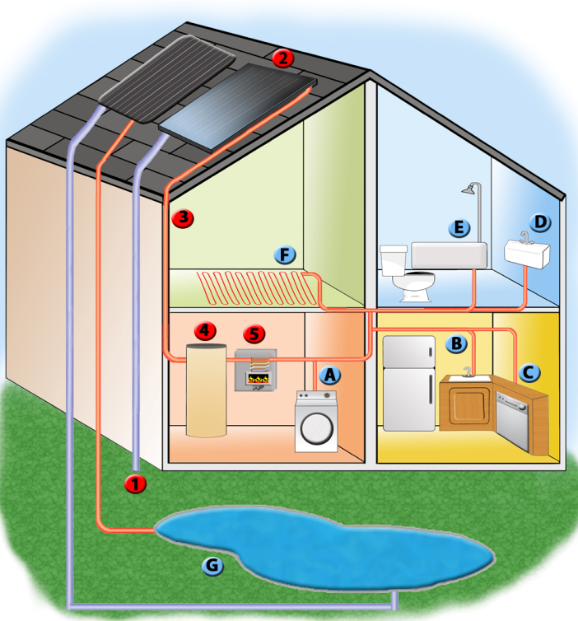
Created by Melissa Wendell
Notes:
Several uses in the home:
Pool heating (not eligible for incentive)
Domestic hot water (sinks, showers, laundry, dishwasher)
Radiant space heating

Slide 7
Types of SWH Systems
2 Types of Basic Systems
  Passive – no pumps
  Active – uses pumps to move the water through the collector

Slide 8
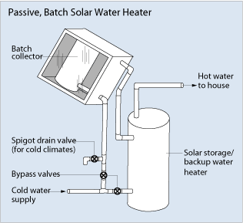
Passive Systems – Batch or ICS
Source: EERE
Notes:
As we discuss the systems types, it trends from simple to more complicated, and likewise from less expensive to more expensive.
ICS = Integrated collector and storage
No pump, water moves through system due to draw of hot water from the home
Freeze protection = thermal mass
Lower performance system appropriate for household with smaller hot water load

Slide 9
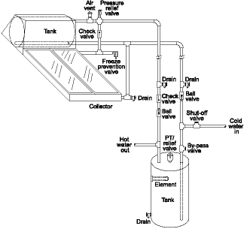
Passive Systems - Thermosyphon
Source: FSEC
Notes:
No pump – water moves through tank based on household hot water draw
Collectors have propylene glycol (anti-freeze) which circulates in a closed loop with heat exchanger in the tank

Slide 10
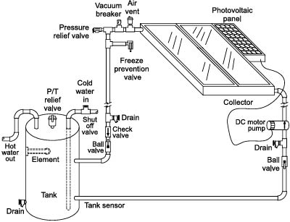
Active Systems – Open Loop
Source: FSEC
Notes:
Has a pump – this system is only allowed in our program in areas along the coast
The water that comes out of the tap is the water which moves through the collector
Not as reliable for freeze protection

Slide 11
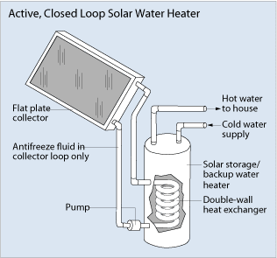
Active Systems – Closed Loop
Source: EERE
Notes:
Has pump – propylene glycol (anti-freeze) moves through the closed loop system: through the collector and heat exchanger

Slide 12
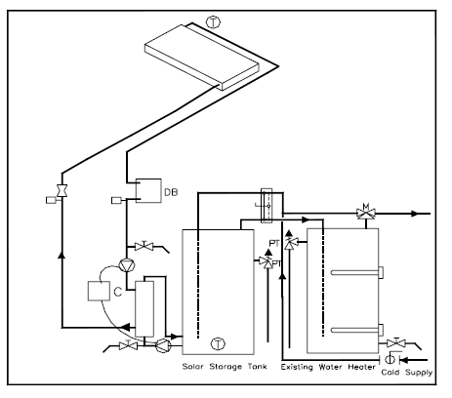
Active System - Drainback
Notes:
Has pump – addresses two major concerns of freezing and overheating by draining the fluid from the collector when it is too cold or too hot.
At the end of each day, the pump shuts down, fluid naturally drains into the drainback tank. No fluid is in the collector and therefore it can’t freeze at night. During the day, if the desired temperature is reached in the storage tank, then the pump shuts off and the fluid is drained from the collector – this prevents “super-heating” of the fluid which could damage the system.

Slide 13
Collector Types
Unglazed (Pool Systems)
Integrated Collector and Storage (ICS)
Thermosyphon
Glazed Flat-Plate
Evacuated Tube

Slide 14
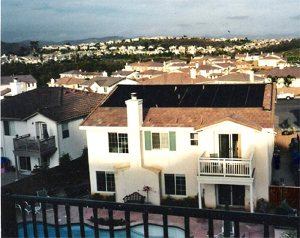
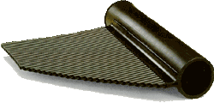
Collector Types
Unglazed Collector (pools)
Source: FAFCO Son Energy
Notes:
Not eligible for incentives, because already cost-effective.

Slide 15
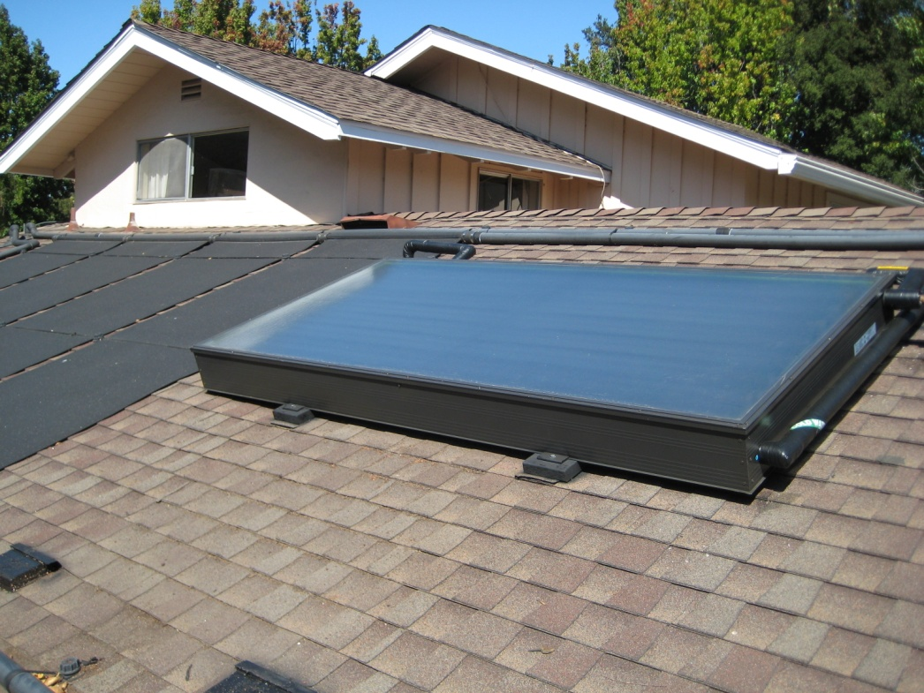
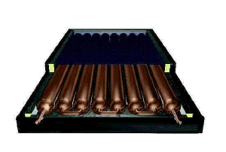
Collector Types - Passive
ICS
Source: SunEarth CPAU
Notes:
Holds 40-60 gallons of water in large copper tubes

Slide 16

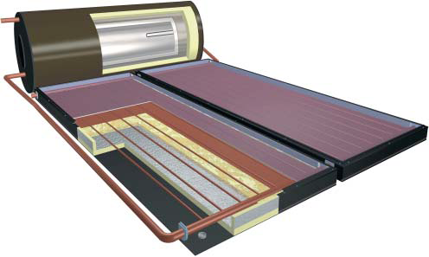
Collector Types - Passive
Thermosyphon
Source: SunEarth CleanTech
Notes:
Tank is 80 gallons on the roof.

Slide 17
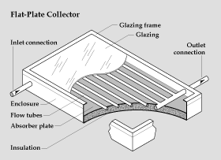
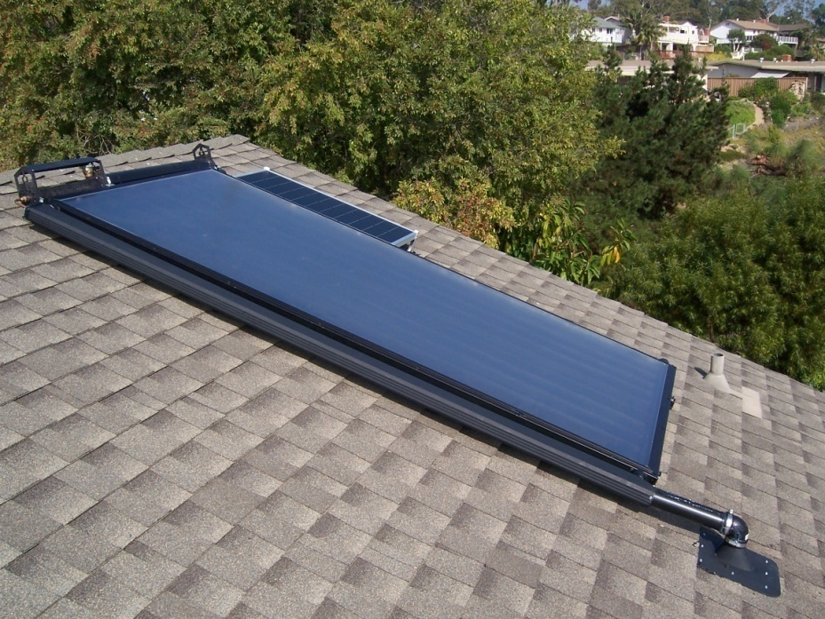
Collector Types - Active
Glazed Flat-Plate
Source: EERE Butler Sun Solutions
Notes:
Weigh less than 5 lbs./sq. ft. roof loading

Slide 18
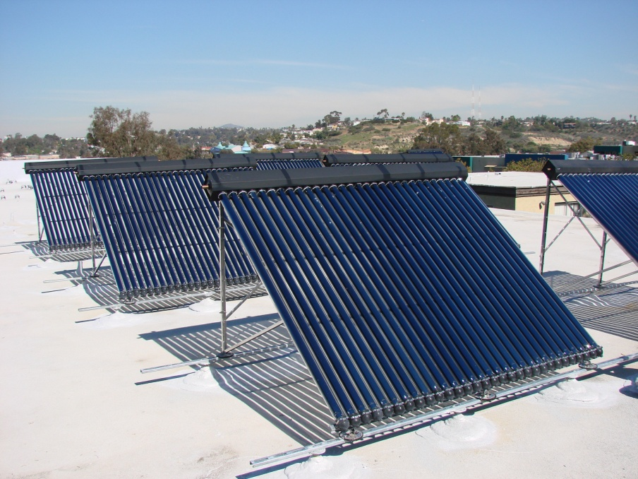
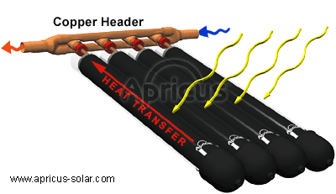
Collector Types - Active
Evacuated Tube Collector
Source: Apricus CleanTech
Notes:
Manufactured in China. Most appropriate for cold climates.

Slide 19
What is the SWHPP?
The Solar Water Heating Pilot Program, part of the larger California Solar Initiative, was designed to gather information on the market, technologies and financials of SWH in order to expand to a statewide program.
  Total SWHPP budget is $1.5 million for incentives
  Program rolled out on July 2, 2007 and will run through Dec. 31, 2009 or until the funding is exhausted
  One year of data collection on all monitored systems (up to 100)

Slide 20
SWHPP, continued
  Eligibility
    Available only to SDG&E electric customers, nowhere else in the state
    New Construction is eligible
    Pools and Spas are not eligible
    Installations must use Solar Rating and Certification Corporation (SRCC) OG-300 systems
    Maximum $1500 for residential installations
    Replacement systems may re-use existing copper pipes
    Replacement of single components is not eligible

Slide 21
SWHPP, cont’d
Program Installation Requirements
  Eligible Contractor
  SRCC Equipment
  Freeze Protection
  Scald Protection
  Permit
  CCSE Inspection

Slide 22
Incentive Calculation
$1500 Maximum Incentive
Solar Orientation Factor – 0.9 to 1.0 based on tilt and orientation
SRCC Annual Savings of the OG-300 System

Slide 23
Incentive Calculation - Example
$1500 x 1.0 x 140 therms/150 therms = $1,400
  Recirculation Freeze Protection
  4x10 Glazed Flat-Plate Collector
  80 Gallon Solar Storage Tank
  Natural Gas Auxiliary
  Annual Savings of 140 therms
Source: SRCC

Slide 24
Additional Incentives
Federal Tax Credit – 30% of cost (post-incentive) (cap removed)
Increased property value but exempt from increase property tax
Protection against future rate increases

Slide 25
Economics of SWH
Natural Gas Displacement
Installed Cost | $ 6,500
Incentive | $ 1,200
ITC | $ 1,590
Net Cost | $ 3,710
Estimated Annual Performance | 130
Utility Rate Escalation | 7%
Cost/Therm Saved after incentive and ITC | $ 1.14
 | Years
 | 1 | 2 | 3 | 13 | 14 | 25 | TOTAL
Therm Cost | $ 1.36 | $ 1.46 | $ 1.56 | $ 3.06 | $ 3.28 | $ 6.90
Energy Savings | 130 | 130 | 130 | 130 | 130 | 130 | 3250
Cost Savings | $ 176.80 | $ 189.18 | $ 202.42 | $ 398.19 | $ 426.06 | $ 896.79 | $ 11,182.43
Cumulative Savings | $ 176.80 | $ 365.98 | $ 568.39 | $ 3,560.87 | $ 3,986.93 | $ 11,182.43
Lbs. CO2 Saved | 38,089
Notes:
Point out that the payback in about 13 years, but there is a continued savings of over $7000 for the life of the system. Based on a 25 year life, the homeowner will see a cost per therm of $1.14, already less than the 2008 average of $1.36/therm.

Slide 26
Economics of SWH
Electricity Displacement
Installed Cost | $ 6,500
Incentive | $ 1,200
ITC | $ 1,590
Net Cost | $ 3,710
Estimated Annual Performance | 2700
Utility Rate Escalation | 5%
Cost/kWh Saved after incentive and ITC | $ 0.05
 | Years
 | 1 | 2 | 3 | 7 | 8 | 25 | TOTAL
kWh Cost | $ 0.15 | $ 0.16 | $ 0.17 | $ 0.20 | $ 0.21 | $ 0.48
Energy Savings | 2700 | 2700 | 2700 | 2700 | 2700 | 2700 | 67500
Cost Savings | $ 405.00 | $ 425.25 | $ 446.51 | $ 542.74 | $ 569.88 | $ 1,306.17 | $ 19,329.48
Cumulative Savings | $ 405.00 | $ 830.25 | $ 1,276.76 | $ 3,297.51 | $ 3,867.39 | $ 19,329.48
Lbs. CO2 Saved | 26,992
Notes:
Point out that the payback in about 7 years, but there is a continued savings of over $15000 for the life of the system. Based on a 25 year life, the homeowner will see a cost per kWh of $0.05, already less than the 2008 average of $0.15/kWh.
Propane systems will have similar economics to electric displacing systems.

Slide 27
Environmental Economics of SWH
NG offset –
Electric offset –
Equivalents
  2004 Toyota Corolla driven 12,000 miles/yr
    8,095 lbs. CO2/year
    NG offset = no driving for 4.7 years
    Electric offset = no driving for 3.3 years
  Trees
    Absorb 2,000 lbs. CO2/year
    NG offset = planting 19 trees
    Electric offset = planting over 13 trees
Lbs. CO2 Saved | 38,089
Lbs. CO2 Saved | 26,992

Slide 28
10 Tips for Hiring a Contractor
1. Hire only licensed contractors
Check the contractor's license number by calling the Contractors State License Board at 1-800-321-2752 or visiting www.cslb.ca.gov.
2. Hire insured contractors
Always insist upon a certificate of insurance for general liability insurance. Uninsured workers who are injured on the job can file damage claims against the homeowner.
3. Verify Workers' Compensation Insurance
California requires this form of insurance for any employer with one or more employees. If your contractor is exempt from the workers' compensation requirement, it means any workers on the job must belong to another subcontractor who is insured.
4. Get references
Always get at least three references from previous customers of the contractor, and review past work.
5. Get multiple bids
Get three (3) bids and use a written plan, so you can compare apples to apples.
6. Get a thorough written contract before any work begins
Any work valued at over $500 requires a contract. In the contract, be sure to specify the start and completion dates of the job, and insist on a progressive payment schedule that is spelled out in dollars and cents. If you're going to spend thousands of dollars, consider investing another $200 to have an attorney review your contract for your protection.
7. Never sign a contract under pressure
Insist on at least 48 hours to study any contract.
8. Pay as you go
To start a job, never pay more than 10% down or $1,000--whichever is less. Hold back 10% for the final payment after the entire job is complete. Never pay for work before it is done.
9. Never pay cash
Pay by check or credit card.
10. Keep a job file
Put receipts, permits, plans and anything else pertaining to your job in the file.
Source: California Contractors State Licensing Board

Slide 29
The SWHPP Team
Annie Henderson – Program Manager
  Annie.Henderson@energycenter.org
  858.244.7290
Skip Fralick – SWH Energy Engineer
  Skip.Fralick@energycenter.org
  858.244.4868
Mike Bigelow – Program Assistant
  Mike.Bigelow@energycenter.org
  858.244.7292
Eligible Contractors
  http://www.swh.energycenter.org

